Slide 1
Results of the Primary Endpoint of the Platinum Plus Trial A Prospective, Randomized, Multi-center Trial to Assess the Everolimus-Eluting Coronary Stent System (PROMUS Element) for Coronary Revascularization in a Population of Unrestricted Patients
Jean Fajadet, Eulogio Garcia, Franz-Josef Neumann, David Hildick-Smith, Sonia Petronio, Mark Spence, Jochen Wöhrle, Azfar Zaman, Simon Elhadad, Sigmund Silber on behalf of the Platinum Plus Trial Investigators
The Platinum Plus study is an investigator-initiated trial made possible by an unrestricted grant by Boston Scientific.

Slide 2
Disclosure Statement of Financial Interest
I, Jean Fajadet DO NOT have a financial interest/arrangement or affiliation with one or more organizations that could be perceived as a real or apparent conflict of interest in the context of the subject of this presentation.

Slide 3
The Platinum Plus Trial Objective
To determine the safety and effectiveness of Boston Scientific’s Everolimus-eluting coronary stent system (PROMUS Element™) for coronary revascularization in an unrestricted population compared to the Xience Prime™ control from Abbott Vascular.

Slide 4
The Platinum Plus Trial Background
A drug-eluting stent consists of 3 components of equal importance: a metallic platform, a polymer and a drug, all influencing acute and long term results both in safety and efficacy.
Promus Element™
(CE mark 3rd Nov 2009)
Xience Prime™
(CE mark 4th Jun 2009)
Same polymers: [poly (n butyl methacrylate) (PBMA) and poly (vinylidene fluoride co hexafluoropro-pylene) (PVDF-HFP)]
Same drug: Everolimus
Different platforms and distinct stent design:
PROMUS ElementTM: platinum-chromium alloy
Xience PrimeTM: cobalt-chromium alloy

Slide 5
The Platinum Plus Trial Design
‘All-comer’ 2,980 patients with coronary artery disease
No exclusion criteria except for EF < 20%
RVD≥2.5 to ≤4.25
Randomized 2:1
Promus Element™
Xience Prime™
ASA indefinitely, thienopyridine ≥ 6mos
Clinical Follow-up
One-month, 12-month (primary endpoint) and 24-month
Primary Endpoint
Target Vessel failure (TVF) of the PROMUS Element™ Everolimus-Eluting Coronary Stent at 12 months post-procedure.
TVF: any ischemia-driven revascularization of the target Vessel (TVR), MI (Q-wave and non- Q-wave) related to the target vessel, or cardiac death related to the target vessel

Slide 6
The Platinum Plus Trial Non-inferiority Study Hypothesis
If the one-sided upper 95% confidence bound on the difference between treatment groups in 12-month TVF (PROMUS Element – Xience Prime) is less than the non-inferiority margin, PROMUS Element will be concluded to be non-inferior to Xience Prime.
Assumptions:
Expected PROMUS Element (test) TVF rate = 7%
Expected XIENCE PRIME (control) TVF rate = 7%
Non-inferiority margin (Δ) = 3.0%
Power (1−β) = approximately 0.80
Expected rate of attrition = 10%

Slide 7
The Platinum Plus Trial Secondary endpoints
Clinical endpoints measured at 30 days, 12 months and 2 years:
Ischemia Driven Target Lesion Revascularization (TLR) rate
Ischemia Driven Target Vessel Revascularization (TVR) rate
Target Lesion Failure (TLF), defined as (TLR), MI (Q-wave and non-Q-wave) related to the target vessel, or cardiac death related to the target vessel
Myocardial Infarction (MI) rate: Q-wave and non-Q-wave, cumulative and individual
Cardiac death rate
Non-cardiac death rate
All death or MI rate
All Death/MI/TVR rate
Major Adverse Cardiac Event (MACE) rate defined as a composite of death, MI (Q wave or non-Q wave), emergent coronary artery bypass surgery (CABG), or TLR by repeat PTCA or CABG.
Stent Thrombosis (ST) rate using ARC definition of definite and probable stent thrombosis and categorized as early, late or very late.

Slide 8
The Platinum Plus Trial – Organization Study Organization
Principal investigator | Jean FAJADET Clinique Pasteur, Toulouse, France Eulogio GARCIA Hospital Clinico San Carlos, Madrid, Spain
Steering Committee | David HILDICK-SMITH Royal Sussex County Hospital, Brighton, UK Franz-Josef NEUMANN Herzzentrum Bad Krozingen, Germany A. Sonia PETRONIO Ospedale di Cisanello, Pisa, Italy Sigmund SILBER Kardiologische Praxis und Praxisklinik, München, Germany
Clinical Events Committee | Kristian THYGESEN ( chair) - DK Jacques MACHECOURT - FR Philippe MENASCHE - FR
Data Safety and Monitoring Committee | Michel BERTRAND (Chair) - FR Olivier VARENNE - FR Christian HAMM - DE Jean-Jacques GOY - CH
Study Coordination and Management

Slide 9
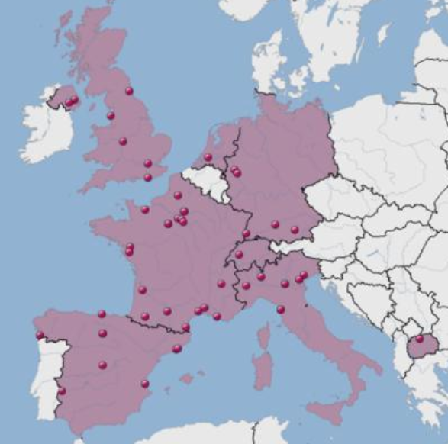
The Platinum Plus Trial – Centres
48 active centres in 8 European countries

Slide 10
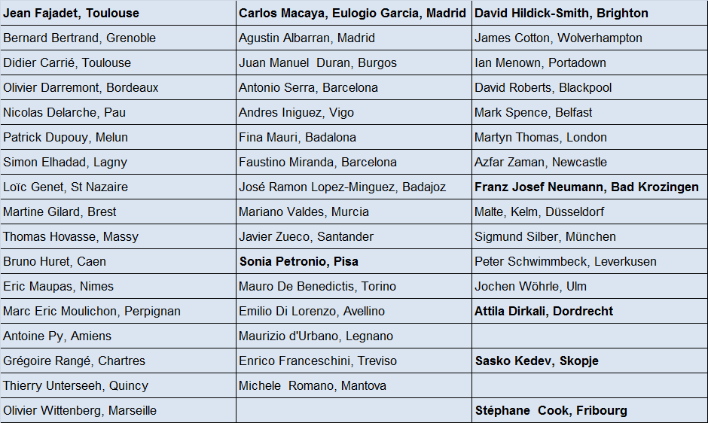
The Platinum Plus Trial – PIs

Slide 11
The Platinum Plus Trial – Enrollment
2980 patients enrolled between October 2010 and February 2012
Top 10 enrollers
Patients Patients
Franz-Josef Neumann 217 David Roberts 136
Herzzentrum Bad Krozingen, Germany Lancashire Cardiac Centre, Blackpool, UK
Azfar Zaman 183 Thomas Hovasse 134
Freeman Hospital Newcastle, UK Hôpital J. Cartier ICPS, Massy, France
Marc Spence 171 Thierry Unterseeh 132
Royal Victoria Hospital, Belfast, UK CHP C. Gallien, Quincy, France
Jochen Wöhrle 169 Marc Eric Moulichon 120
Universitätsklinikum Ulm, Germany Clinique Saint Pierre, Perpignan, France
Simon Elhadad 142 Mariano Valdes 120
CH Lagny, Lagny , France Hospital V de la Arrixaca, Murcia, Spain

Slide 12
Patient Flow
All Patients Randomized N=2980
PROMUS Element™
N = 1952
Xience Prime™
N = 1028
Not evaluable at
30d FU (N=17)
Consent withdrawn: 5 No sufficient FU: 6 Other: 6
Not evaluable at
30d FU (N=3)
Consent withdrawn: 0 No sufficient FU: 2 Other: 1
Not evaluable at 12M FU (N=90)
Consent withdrawn : 5 No sufficient FU : 78 Other: 7
Not evaluable at 12M FU (N=41)
Consent withdrawn : 1 No sufficient FU: 38 Other: 2
12 Mo Follow-up*
95.4% (1862/1951)
12 Mo Follow-up*
96.0% (987/1028)
*Follow up rate for clinical endpoint
Notes:
12

Slide 13
The Platinum Plus Trial Baseline Characteristics of the Study Population
 | Promus Element™ (N=1951) | Xience Prime™ (N=1028) | p value
Age, yrs | 65.68 ± 10.54 | 66.12 ± 10.73 | 0.29
Male gender | 77.65 % | 78.40 % | 0.64
Stable angina | 45.22 % | 44.60 % | 0.75
ACS (ACS ST+, ACS ST-) | 33.18 % | 33.11 % | 0.97
Silent ischemia | 10.65 % | 11.39 % | 0.54
Hypertension | 68.01 % | 68.61 % | 0.74
Hypercholesterolemia | 63.40 % | 62.19 % | 0.52
Diabetes II | 26.31 % | 23.87 % | 0.15
Insulin Treated Diabetes | 7.80 % | 7.12 % | 0.51
Prior Myocardial Infarction | 21.72 % | 24.34 % | 0.10
Current Smoker | 21.96 % | 20.86 % | 0.49
Family History | 34.85 % | 35.01 % | 0.94

Slide 14
The Platinum Plus Trial Procedural Characteristics
 | Promus Element™ (N=1951) | Xience Prime™ (N=1028) | p value
Transradial vascular Access | 61.99 % | 62.20 % | 0.91
Access sheath size 5F and 6 F | 95.51 % | 94.13 % | 0,09
Access sheath size ≥ 7F | 4.49 % | 5.87 % | 0,09
Multiple target vessel | 48.82 % | 47.32 % | 0.44
Mean number of stent/patient | 1.76 ± 1,06 | 1.80 ± 1,12 | 0,64
Total stent length/patient | 35.93 ± 24.78 mm [range : 8 – 240 mm] | 35.84 ± 25,20 mm [range 8 – 201 mm] | 0,51
Mean stent diameter | 2.97 ± 0.46 mm | 2.97 ± 0.46 mm | 0.97
Procedural success | 97.61 % | 97.86 % | 0,66

Slide 15
The Platinum Plus Trial 30d Outcome¹
 | Promus Element™ (N=1935) | Xience Prime™ (N=1025) | p value²
TVF | 1.3 % | 0.9 % | 0.27
All death | 0.6% | 0.5% | 0.78
Cardiac death | 0.5% | 0.5% | 0.92
All MI | 0.7% | 0.5% | 0.54
Q wave MI | 0.2% | 0.0% | 0.31
Non Q wave MI | 0.5% | 0.5% | 1.0
Ischemia driven –TLR | 0.3% | 0.1% | 0.43
Ischemia driven - TVR | 0.4% | 0.2% | 0.73
MACE | 1.3% | 1.0% | 0.39
Stent thrombosis – Definite or Probable | 0.6% | 0.3% | 0.40
¹Preliminary 30d data presented at TCT 2012 – final, fully adjudicated data shown here
²p-value for superiority

Slide 16
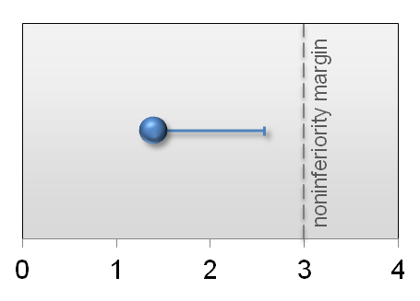
The Platinum Plus Trial Primary Endpoint — 12-Month TVF
Difference [95% UCB]
(1-sided Farrington Manning Upper Confidence Bound)
Promus Element (N=1935) | Xience Prime (N=1025) | Difference [1-sided 95% UCB] | P value (non-inferiority)
4.6% (86/1862) | 3.2% (32/987) | 1.4% [2.57%] | 0.0124
Percent
The non-inferiority endpoint is met as the one-sided upper 95% confidence bound is less than the non-inferiority margin

Slide 17
The Platinum Plus Trial 12-Month - Outcome
 | Promus Element™ (N=1862) | Xience Prime™ (N=987) | p value*
TVF | 4.6% | 3.2% | 0.08
All death | 1.8% | 1.5% | 0.62
Cardiac death | 1.1% | 1.0% | 0.78
All MI | 1.6% | 0.8% | 0.09
Q wave MI | 0.2% | 0.3% | 0.70
Non-Q wave MI | 1.3% | 0.6% | 0.07
Ischemia driven –TVR | 3.2% | 2.0% | 0.08
Ischemia driven - TLR | 2.0% | 1.6% | 0.49
MACE | 4.7% | 3.9% | 0.31
Stent thrombosis Definite or Probable | 0.8% | 0.5% | 0.44
*p-value for superiority

Slide 18
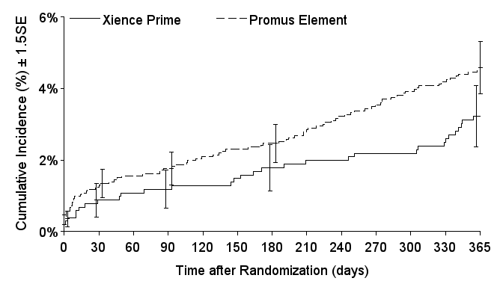
The Platinum Plus Trial 12-Month Outcome: Cumulative Incidence of TVF
4.6%
p value Log-Rank: 0.077
3.2%

Slide 19
The Platinum Plus Trial Conclusion
The PLATINUM PLUS trial was designed to demonstrate the non-inferiority of the Promus Element™ vs the Xience Prime™ stent in an all-comer population.
The primary endpoint (TVF at 12M, defined as any ischemia-driven revascularization of the target Vessel [TVR], MI [Q-wave and non-Q-wave] related to the target vessel, or cardiac death related to the target vessel) was met (4.6 % vs 3.2 %, Dif: 1.4%, p-value for non-inferiority: 0.012).
There was no significant difference in any of the secondary endpoints (death, MI, TLR and stent thrombosis at 30d and 1yr).

Slide 21
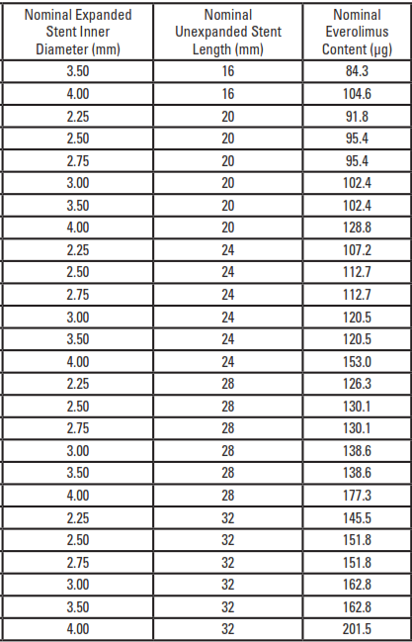
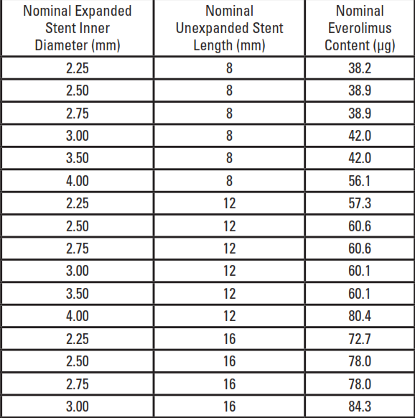
The Platinum Plus Trial
Stent sizes and drug content: Promus Element™

Slide 22
The Platinum Plus Trial
Stent sizes and drug content: Xience Prime™

