Slide 1
Can Passive Coatings Make a Difference?
Results With the COBRA PzF NanoCoated Coronary Stent
On Behalf of the PzF SHIELD investigators
Sigmund Silber MD, PhD
FESC, FACC, FAHA
Co-Principal Investigator
Professor of Medicine
Heart Center at the Isar
Munich, Germany

Slide 2
Disclosure Statement of Financial Interest
Within the past 12 months, I or my spouse/partner have had a financial interest/arrangement or affiliation with the organization(s) listed below.
Affiliation/Financial Relationship
Company
Grant/Research Support
CELONOVA

Slide 3
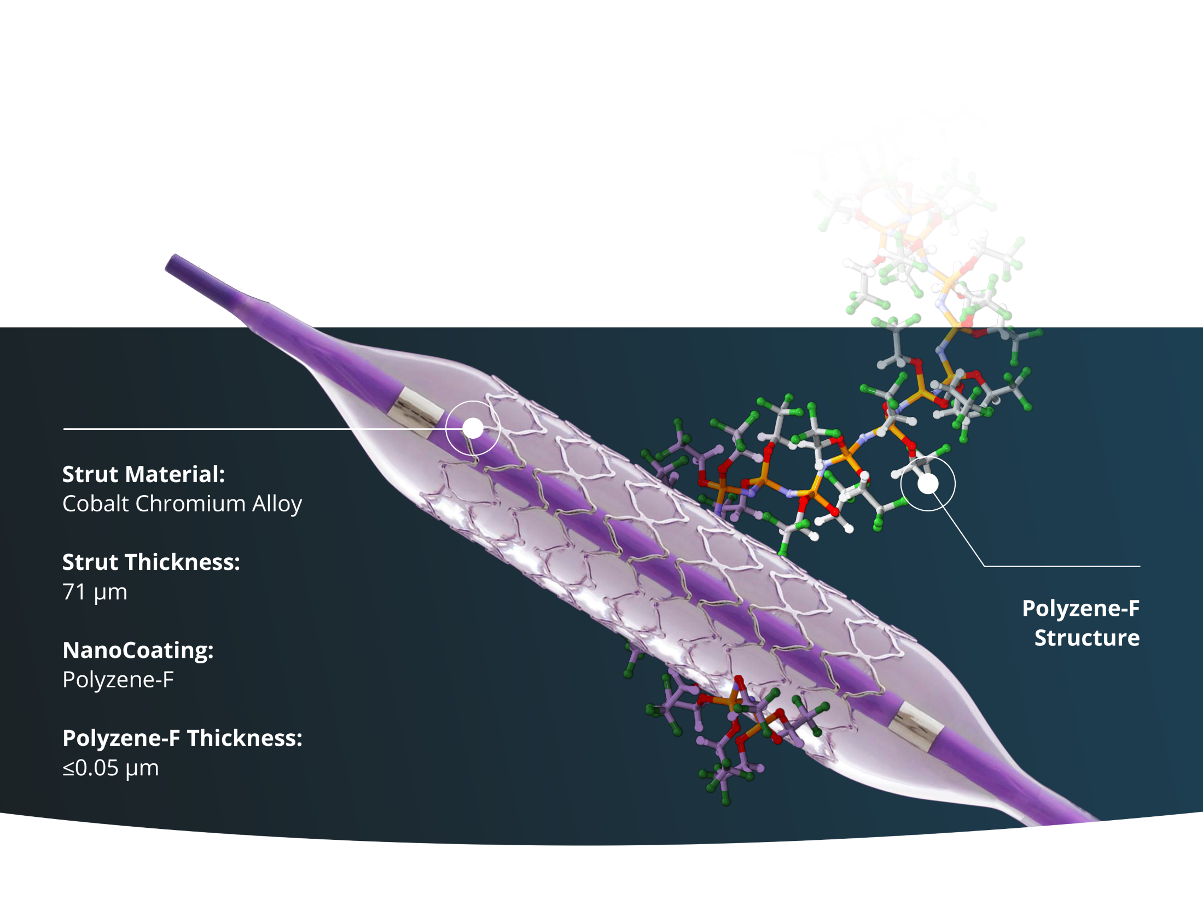

The COBRA PzF NanoCoated Stent (NCS) System
An Investigational Device in the U.S.
Not Available for Sale in the U.S.

Slide 4
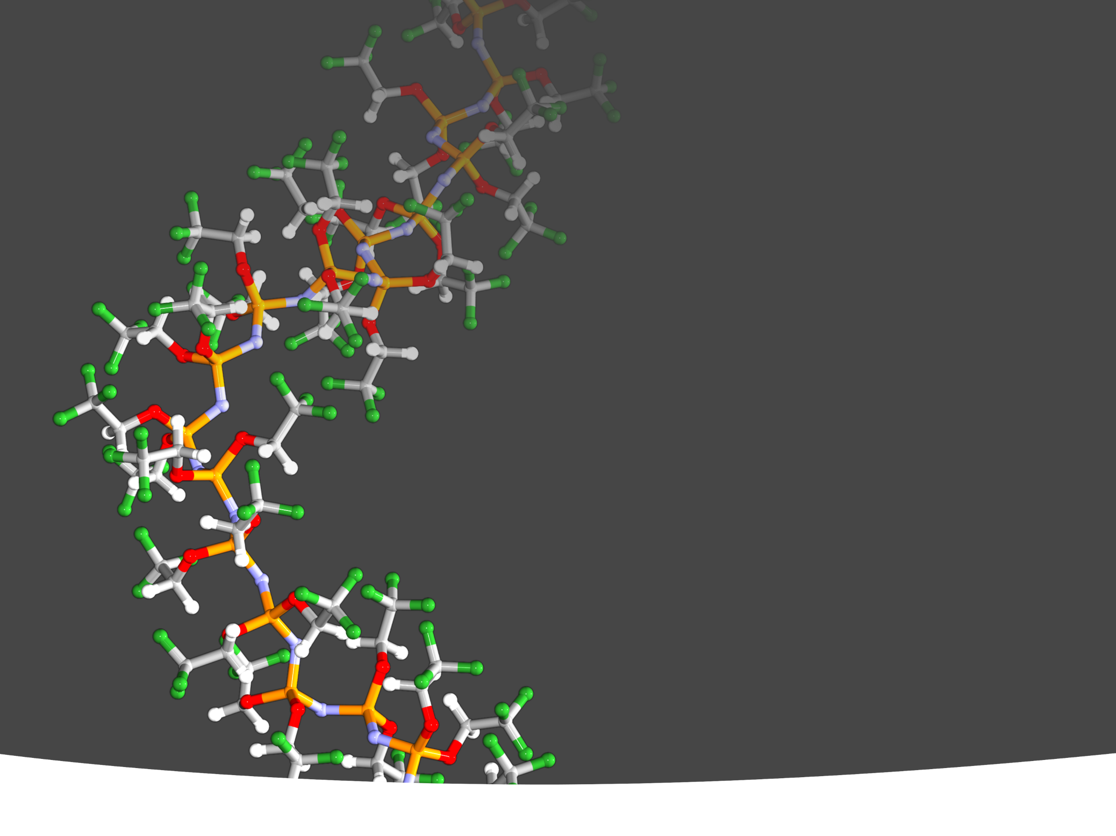
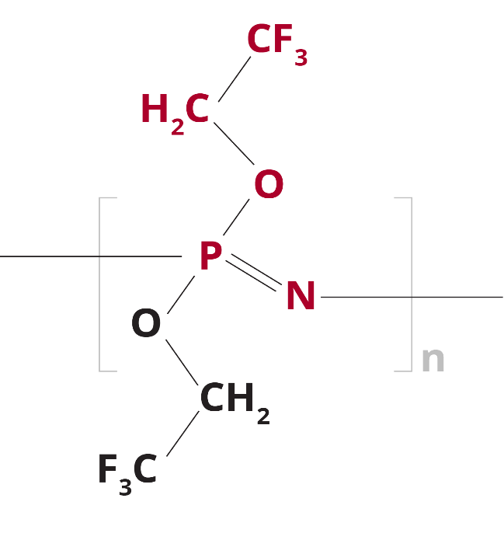
Polyzene-F
The Trifluoroethoxy (TFE) Side Groups
Polyzene-F is an ultra pure, inert compound with unique side chains and has shown protein stabilizing properties*
High molecular weight polymer coating Poly [bis (trifluoroethoxy) phosphazene] ≤0.05 µm thin, durable, highly elastic
Polyzene-F has shown to stabilize the conformation of adsorbed proteins*
Polyzene-F has shown to adsorb preferentially albumin over fibrinogen*
*Tur et al, Journal of Applied Medical Polymers, 2000, 4, 1

Slide 5
Previous Polyzene-F Stent Clinical Data
First Generation Catania PzF Stent
One Year Clinical Outcomes
Trial | N | Late Loss | TLR | SAT | Late ST
ATLANTA FIM¹ | 55 | 0.06 ± 0.48 | 3.6% | 0% | 0%
ALTALNTA II² | 300 | N/A | 6.5% | 0.7% | 0%
ATLANTA FME³ | 379 | N/A | 3.9% | 0.3% | 0%
1. C. Tamburino et al. JACC Intv. 2009;2:197-204 2. C. Tamburino et al. Eurointervention 2012;7:1062-8
3. E. Teiger Euro PCR 2011

Slide 6
PzF SHIELD Trial Design
Multi-center, prospective, single-arm
Control comparator = performance goal derived from historical clinical trials including one or more BMS arms
Primary endpoint = target vessel failure (cardiac death, target vessel related MI, including peri-procedural MIs, TVR) at 9 months
Powered secondary endpoint = late lumen loss at 9 months in a pre-specified subset with planned angiographic follow-up
Completed clinical follow-up mandated prior to follow-up angiography to avoid impact of angiographic follow-up bias

Slide 7
Statistical Methods
Performance Goals
9 month TVF from meta-analysis of 5 clinical trial BMS arms = 10.62%.
Based on ARC MI definition (+3%) and margin for superiority test (6%), PG = 19.62%.
For alpha = 5% and power = 85% sample size = 281 pts; Planned enrollment = 296 to allow for 5% lost to follow-up.
For late loss (LL) assumed PG of 1.1 mm and 0.9 mm for COBRA PzF. Sample size = 90 provides >85% power. Planned to enroll first 130 consented patients to account for up to 30% lost to follow-up.

Slide 8
Trial Organization
Coordinating Principal Investigators | Donald Cutlip, MD Beth Israel Deaconess Medical Center Boston, MA USA Sigmund Silber, MD, FESC, FACC, FAHA Heart Center at the Isar München, Germany
Angiographic Core Lab | Beth Israel Deaconess Medical Center Boston, MA USA
Clinical Events Committee, Data Monitoring Committee, & ECG Core Lab | Harvard Clinical Research Institute Boston MA USA
Optical Coherence Tomography (OCT) Core Laboratory | Cardiovascular Core Analysis Laboratory Stanford University Medical Center
Sponsor | CeloNova Biosciences, Inc.

Slide 9






EU Participating Sites
Site | PI | Location | Enrolled
Latvian Centre of Cardiology | Andrejs Erglis | Riga, Latvia | 27
Kardiologische Praxis und Praxisklinik | Sigmund Silber | Munich, Germany | 22
Clinique Axium | Luc Maillard | Aix-en-Provence, France | 16
Clinique St. Hilaire | Jacques Berland | Rouen, France | 15
Klinicki Centar Srbija | Goran Stankovic | Belgrade, Serbia | 12
Hospital de la Santa Creu i Sant Pau | Antonio Serra | Barcelona, Spain | 10
Centre Hospitalier François Mitterrand | Nicolas Delarche | Pau, France | 9
Hospital Clínico San Carlos | Antonio Fernandez-Ortiz | Madrid, Spain | 6
CardioVasculaeres Centrum | Horst Sievert | Frankfurt, Germany | 5
Kantonsspital St. Gallen | Daniel Weilenmann | St. Gallen, Switzerland | 4
Hôpital Henri Duffault | Jean-Lou Hirsch | Avignon, France | 2
Clinique du Diaconat | John Shayne | Mulhouse, France | 1
Hopital Albert Schweitzer | Laszlo Levai | Colmar, France | 1

Slide 10

US Participating Sites
Site | PI | Location | Enrolled
Northshore/ LIJ/ Lennox Hill Hospital | Rajiv Jauhar/Kirk Garratt | New York, NY | 56
Baylor Medical Center | Robert Stoler | Dallas, TX | 14
Texas Plaza Medical Center | Amir Malik | Fort Worth, TX | 13
Tyler Cardiovascular Consultants | Thaddeus Tolleson | Tyler, TX | 11
Texas Cardiac Center | Mohammad Shoukfeh | Lubbock, TX | 10
Deborah Heart and Lung Center | Jon George | Brown Mills, NJ | 9
Beth Israel Deaconess Medical Center | Donald Cutlip | Boston, MA | 7
Louisiana Heart Hospital | Pramod Menon | Lacombe, LA | 7
St Joseph’s Hospital | Ronald Caputo | Liverpool, NY | 5
Bakersfield Memorial Hospital | Tommy Lee | Bakersfield, CA | 4
Mt Sinai Medical Center | Srinivas Kesanakurthy | New York, NY | 4
Oklahoma Foundation for Cardiovascular Research | Thomas McGarry | Oklahoma City, OK | 4
San Antonio Endovascular Heart Institute | Stefan Kiesz | San Antonio, TX | 4
Heart Hospital, Baylor Research Institute | David Brown | Dallas, TX | 3
Houston Methodist Hospital | Alpesh Shah | Houston, TX | 3
Virginia Cardiovascular Specialists | Charles Phillips | Richmond, VA | 3
Heart Center of Indiana | Michael Ball | Indianapolis, IN | 2
Mt Sinai Medical Center | Nirat Beohar | Miami Beach, FL | 2
Southern Oregon Cardiology | Mark Huth | Medford, OR | 2
Aspirus Heart & Vascular Institute | German Larrain | Wausau, WI | 1
Emory Healthcare | Aloke Finn | Atlanta, GA | 1
York Hospital | William Nicholson | York, PA | 1

Slide 11
Baseline Characteristics
Characteristics | N=296 patients
Male | 70.3 %
Age | 66.5 ± 10.3
History of coronary artery disease | 48.6 %
Prior MI | 14.9 %
Prior PCI | 30.4 %
History of CABG | 5.1 %
Prior Stroke | 4.8 %
Peripheral Vascular Disease | 9.2 %
Diabetic (Oral Meds or IDDM or Diet controlled) | 33.7 %
Insulin dependent diabetics | 22.2 %
Chronic Renal Failure | 5.8 %
Atrial Fibrillation | 12.2 %
Heart Failure | 11.6 %
History of Smoking (Current) | 56.8 % (22.1 %)

Slide 12
Indication for the Procedure
Indication | N=296 patients
Stable Angina | 54.7 %
Unstable Angina | 29.4 %
Positive Functional Study without Angina | 13.5 %
Acute MI (>72 hours) | 2.4 %

Slide 13
Baseline Angiographic and Procedural Data
Characteristics | N=296 patients/ 300 lesions
Lesion Location
LAD | 36 %
LCX | 21.3 %
RCA | 42.7 %
Target vessel reference diameter mm | 2.7 ± 0.5
Target lesion length mm | 12.8 ± 6.5
Minimum luminal diameter – pre procedure | 0.98 ± 0.4
Lesion classification type B/B2/C | 24.4 % / 52.5 % / 19.4 %
Pre-procedure Stenosis % | 64 ± 11.4
Pre-dilation | 96.28 %
Post-dilation | 48.14 %
Stents implanted per lesion n | 1.06
Stented length per patient mm | 17.9 ± 5.6
Multiple stents implanted | 7.5 %

Slide 14
Post procedural angiographic outcomes (QCA)
Characteristics | N=296 patients (96%)
Post-procedure final stenosis
In-segment | 20.4 ± 7.8 %
In-stent | 7.7 ± 9.1 %

Slide 15
Angiographic Outcomes
IN STENT DIAMETER STENOSIS
1.0
0.9
0.8
0.7
0.6
POST
F/U
PRE
Cumulative Distribution Function
0.5
0.4
0.3
0.2
0.1
0
-40
-20
0
20
40
60
80
100
Diameter Stenosis
Binary angiographic restenosis = 25.6 %
but at F/U only 5 patients had > 70% stenosis

Slide 16
Angiographic Endpoint Results
SECONDARY ENDPOINT
In-Stent Late Loss
97.5% Cl
Performance
Goal = 1.1 mm
LL
0.84 ± 0.48 mm
0
0.5
1
1.5
2
In-Stent Late Loss (mm)

Slide 17
In-Stent Late Loss
Stent Type | Product | Late Loss (mm)
Bare Metal Stent (BMS) | Express¹ | 0.92
BMS | Bx Velocity¹ | 1.0
BMS | Multilink¹ | 0.98
BMS | Driver¹ | 1.03
NanoCoated Stent (NCS) | COBRA PzF | Mean 0.84/Median 0.79
Drug Eluting Stent (DES) | Resolute² | 0.36
DES | Xience² | 0.14
DES | Synergy² | 0.23
1. Pocock, JACC 2005,
2. US IFU

Slide 18
Clinical Endpoint Results
PRIMARY ENDPOINT
9 Month TVF
95% Cl
Performance
Goal = 19.62%
TVF
11.5%
0
10
15.07
20
30
TVF (%)

Slide 19
Clinical Secondary Endpoints
Events | N (%)
0 - 30 Days TVF | 19 (6.4%)
Cardiac Death | 1 (0.4%)
Target Vessel MI (peri-procedural) | 17*(5.8%)
Q wave | 0.0%
Non Q wave | 5.8%
TVR | 1 (0.4%)
TLR | 0
based on
CK-MB
≥ 3 times
of normal,
as per protocol

Slide 20
Clinical Secondary Endpoints
Events | N (%)
0 - 30 Days TVF | 19 (6.4%)
Cardiac Death | 1 (0.4%)
Target Vessel MI (peri-procedural) | 17*(5.8%)
Q wave | 0.0%
Non Q wave | 5.8%
TVR | 1 (0.4%)
TLR | 0
0 - 270 Days TVF | 33 (11.5%)
Cardiac Death | 1 (0.4%)
Target Vessel MI (ARC) | 20 (7.0%)
Q wave | 0.0%
Non Q wave | 7.0%
TVR | 17 (5.9%)
TLR | 13 (4.6%)

Slide 21
Clinical Secondary Endpoints
Events | N (%)
0 - 30 Days TVF | 19 (6.4%)
Cardiac Death | 1 (0.4%)
Target Vessel MI (peri-procedural) | 17*(5.8%)
Q wave | 0.0%
Non Q wave | 5.8%
TVR | 1 (0.4%)
TLR | 0
0 - 270 Days TVF | 33 (11.5%)
Cardiac Death | 1 (0.4%)
Target Vessel MI (ARC) | 20 (7.0%)
Q wave | 0.0%
Non Q wave | 7.0%
TVR | 17 (5.9%)
TLR | 13 (4.6%)

Slide 22
Clinically Driven TLR
U.S. FDA Studies
COBRA PzF 4.6%
Legend: BMS (9 mo. f/u) - DES (12 mo. f/u) -
References: VISION- VISION Registry- IFU, p.7, 2008, Abbott; REBEL- Omega Trial, Wang et. Al. Cardiovascular Reviews in Medicine, 2015; DRIVER- Endeavor II, Fajadet, Circulation 2006; XIENCE- Ellis, et. al., NEJM, 2015; RESOLUTE- RESOLUTE US Trial- Yeung et. al., JACC, 2011; PROMUS- PLATINUM Workhorse Trial- Stone, G., ACC, 2011; ABSORB- Ellis, et. al., NEJM, 2015; SYNERGY- EVOLVE II RCT, Kereiakes, D., AHA, 2014

Slide 23
Stent Thrombosis
(definitive / probable)
Events | N (%)
Early | 0
Late | 0

Slide 24
Stent Thrombosis
(most are definitve / probable)
0 % COBRA PzF
definitive / probable
Legend: BMS (9 mo. f/u) - DES (12 mo. f/u) -
References: VISION- VISION Registry- IFU, p.7, 2008, Abbott; REBEL- Omega Trial, Wang et. Al. Cardiovascular Reviews in Medicine, 2015; DRIVER- Endeavor II, Fajadet, Circulation 2006; XIENCE- Ellis, et. al., NEJM, 2015; RESOLUTE- RESOLUTE US Trial- Yeung et. al., JACC, 2011; PROMUS- PLATINUM Workhorse Trial- Stone, G., ACC, 2011; ABSORB- Ellis, et. al., NEJM, 2015; SYNERGY- EVOLVE II RCT, Kereiakes, D., AHA, 2014

Slide 25
DAPT Duration
(at the discretion of the operator)
DAPT | % of Patients
Discharge | 100%
30 Days | 95%
9 Months | 52%
DAPT | % of Patients
Discharge | 100%
30 Days | 95%
9 Months | 52%

Slide 26
Summary of the PzF SHIELD Study:
The PzF COBRA stent met the primary endpoint of the predefined performance goals for 9 month TVF and in-stent late loss.
MI beyond the peri-procedural period was infrequent.
Clinically driven TLR was low (4.6%) as compared to standard BMS.
With 0% stent thrombosis, the strength of the PzF-shielded stent seems to avoid stent thrombosis.
Therefore, further studies are needed to assess the potential role of the COBRA PzF stent in patients at high risk of bleeding and/or who require abbreviated DAPT.

