Slide 1
Didactic Session: The TCT Late Breaking Trials: Highlights – and my Interpretations – from: BIO-RESORT (TWENTE III) and BIONICS
Sigmund Silber MD, PhD
FESC, FACC, FAHA
Professor of Medicine
Heart Center at the Isar
Munich, Germany

Slide 2
Disclosure Statement of Financial Interest
I, Sigmund Silber, DO NOT have a financial interest/arrangement or affiliation with one or more organizations that could be perceived as a real or apparent conflict of interest in the context of the subject of this presentation.

Slide 3
Didactic Session: The TCT Late Breaking Trials: Highlights – and my Interpretations – from: BIO-RESORT (TWENTE III) and BIONICS
Key data of these studies
Putting these studies into perspective
Did these studies change my everyday practice ?
Conclusions

Slide 4
Didactic Session: The TCT Late Breaking Trials: Highlights – and my Interpretations – from: BIO-RESORT (TWENTE III) and BIONICS
Key data of these studies
Putting these studies into perspective
Did these studies change my everyday practice ?
Conclusions

Slide 5
BIO-RESORT (TWENTE III): A prospective, randomized, three-arm trial comparing two different biodegradable polymer-based drug-eluting stents and a durable polymer-based drug-eluting stent in all-comers with coronary artery disease
Clemens von Birgelen, MD PhD
Thoraxcentrum Twente, MST, Enschede, the Netherlands
on behalf of the BIO-RESORT Investigators

Slide 6
BIO-RESORT: Study Devices
Durable Polymer DES | Biodegradable Polymer DES
Xience/Promus CoCr/PtCr-EES | Resolute Integrity CoCr-ZES | BioMatrix/Nobori 316L-BES | Ultimaster CoCr-SES | Synergy PtCr-EES | Orsiro CoCr-SES | Absorb (BVS) PLLA-EE Scaffold
Thickness (µm) of uncoated strut
81 | 91 | 120 / 125 | 80 | 74* | 60** | 150
Distribution, thickness (µm), and type of polymer
Circumferential7-8/side Fluoro-poymer | Circumfer. 6/side BioLinxTM | Abluminal ≥10 PLA | Abluminal 15 PDLLA | Abluminal 4 PLGA, PCL | Cicumfer. 4-7/side PLLA** | Circumferential 3/side PDLLA
Data from: Stefanini G. et al. Heart 2014 (doi:10.1136/heartjnl-2012-303522); Garg, S. et al. Nat. Rev. Cardiol. 2013;10:248–60; Meredith I.T., presentation at TCT 2013; Lee Y. et al. Invasive Cardiol. 2014;26(2):41-5; and manufacturers’ information (modified, extended). * Synergy‘s platinum chromium strut thickness is 74 µm for stent diameters ≤ 2.5 mm, 79 µm for stent diameters 3.0 – 3.5 mm, and 81 µm for stent diameter 4.0 mm. ** Orsiro‘s cobalt chromium strut thickness is 60 µm for stent diameters ≤ 3.0 mm, and 80 µm for stent diameters > 3.0 mm; Orsiro has an asymmetrical, conformal distribution of the PLLA coating (abluminal coating is thicker) on a very thin passive coating of silicon carbide.
Notes:
5
This is the Bulleted List slide.
To create this particular slide, click the NEW SLIDE button on your toolbar and choose the BULLETED LIST format. (Top row, second from left)
The Sub-Heading and footnote will not appear when you insert a new slide. If you need either one, copy and paste it from the sample slide.
If you choose not to use a Sub-Heading, let us know when you hand in your presentation for clean-up and we’ll adjust where the bullets begin on your master page.
Also, be sure to insert the presentation title onto the BULLETED LIST MASTER as follows:
Choose View / Master / Slide Master from your menu.
Select the text at the bottom of the slide and type in a short version of your presentation title.
Click the SLIDE VIEW button in the lower left hand part of your screen to return to the slide show. (Small white rectangle)

Slide 7
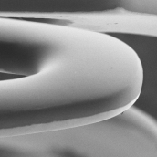
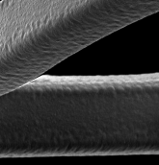
BIO-RESORT: Study Devices
 | SYNERGY | RESOLUTE INTEGRITY | ORSIRO
Coating characteristics | Biodegradable Abluminal | Durable Circumferential Symmetrical | Biodegradable Circumferential Asymmetrical
Bare strut thickness, μm | 74 (3.0 – 3.5 mm: 79, 4.0 mm stent: 81) | 91 | 60 (≥ 3.5 mm stents: 80)
Coating thickness, μm | 4 | 5.6 | 7.4 / 3.5 (ab-/luminal)
Coated strut thickness, μm (of smallest stent) | 78 | 102 | 71
Metal | Platinum-chromium | Cobalt-chromium | Cobalt-chromium
Polymer | PLGA (poly [lactic- co-glycolic acid] polymer) coating | BioLinx®, a blend of hydrophobic C10, hydrophilic C19, and poly-vinyl pyrrolidone | PLLA (poly [L-lactide] acid) (BIOlute®), on thin amorphous silicon carbide (proBIO®)
Drug | Everolimus | Zotarolimus | Sirolimus
Drug release time, mo. | 3 | 6 | 3.3
Degradation time, mo. | 4 | --- | < 24

Slide 8
Study Flow Diagram
3,514 patients randomized and analyzed
(study population)*
1:1:1 randomization following stratification for diabetes mellitus
1,172 pts.
allocated to
SYNERGY
1,173 pts.
allocated to
RESOLUTE INTEGRITY
1,169 pts.
allocated to
ORSIRO
1,162 pts.
completed
1-year follow-up**
1,165 pts.
completed
1-year follow-up#
1,163 pts.
completed
1-year follow-up§
1-year follow-up data were obtained from 99.3% of the study population,
which represents 99.9% of the patients who still participated in the trial or had died.
During the first year of follow-up, 21 patients (0.6%) withdrew consent, while only
3 / 3,514 patients (< 1 ‰) were actually “lost” (i.e., could not be contacted).
* During active study enrollment, 7,928 patients were treated with DES (no data on the number of eligible patients are available).
3,545 pts. were initially randomized; 31 pts. were excluded; 3,514 pts. were analyzed and represent the study population.
** 2 patients lost to follow-up, 8 patients withdrew consent; # 1 patient lost to follow-up, 7 patients withdrew consent;
§ 6 patients withdrew consent. Monitoring and an independent clinical event adjudication (CEC) by CRO Diagram, Zwolle. Analyses were based on intention to treat.

Slide 9
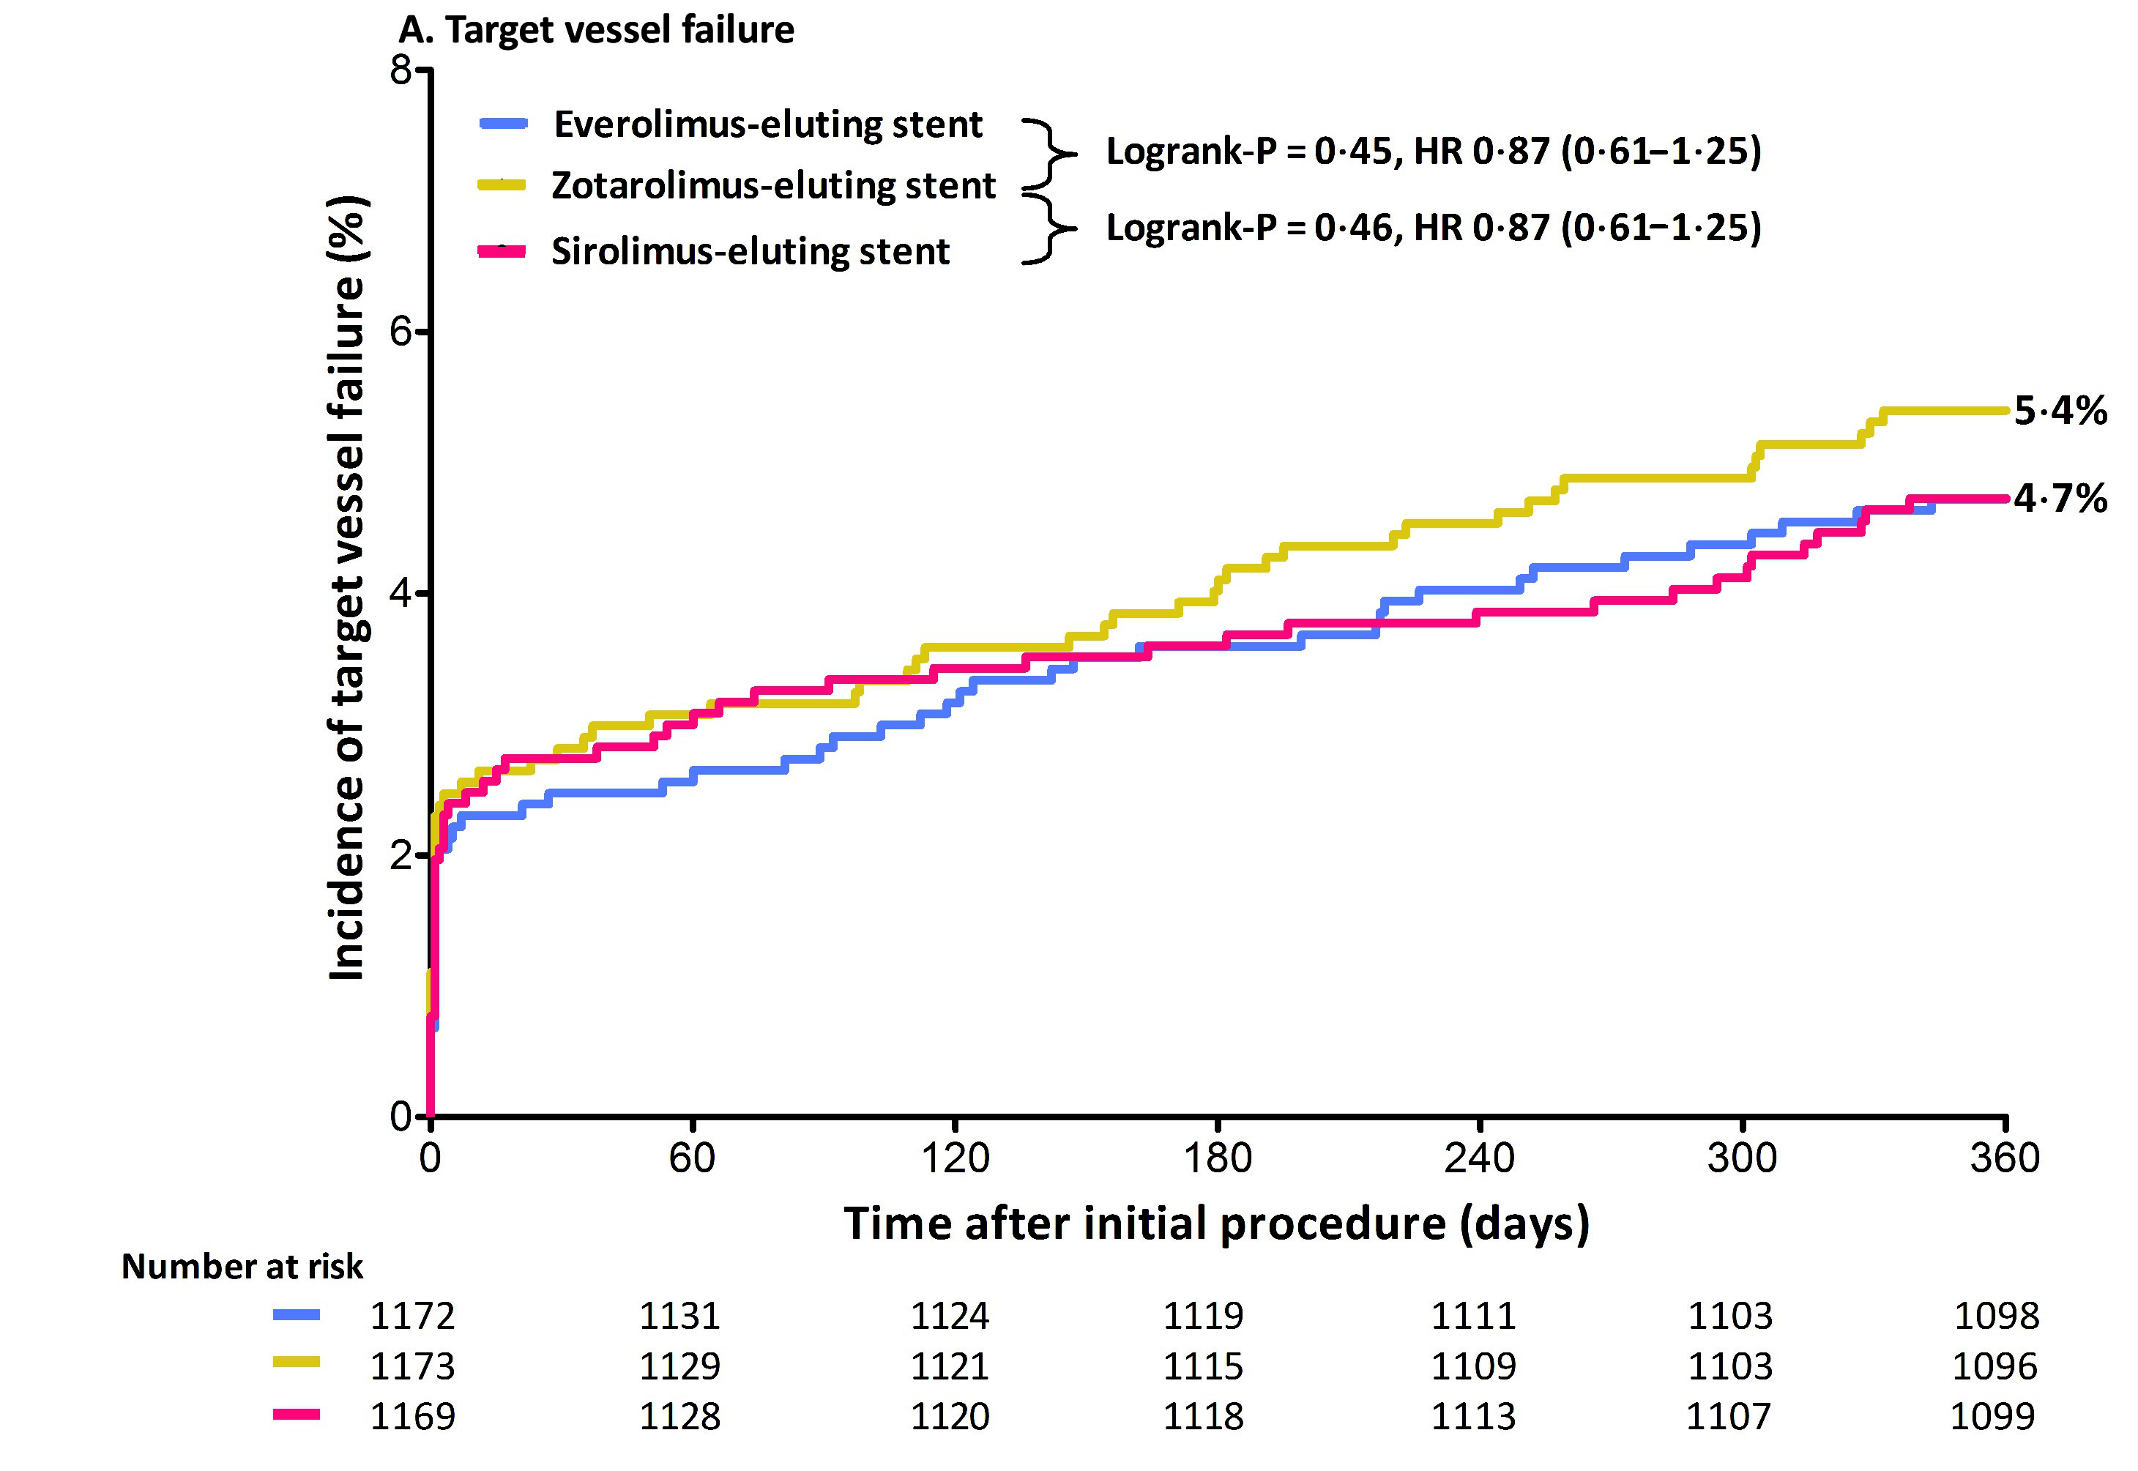
Primary Endpoint Target Vessel Failure at 1-Year Follow-Up
Synergy
Logrank-P = 0.45, HR 0.87 (0.61-1.25)
Resolute Integrity
Orsiro
Logrank-P = 0.46, HR 0.87 (0.61-1.25)
5.4%
4.7%
4.7%
Time after initial procedure (days)
Target Vessel Failure is a composite of cardiac death, target vessel-related MI, or clinically driven target vessel revascularization.
Events displayed in the graph were calculated by Kaplan-Meier methods and compared with the log-rank test.

Slide 10
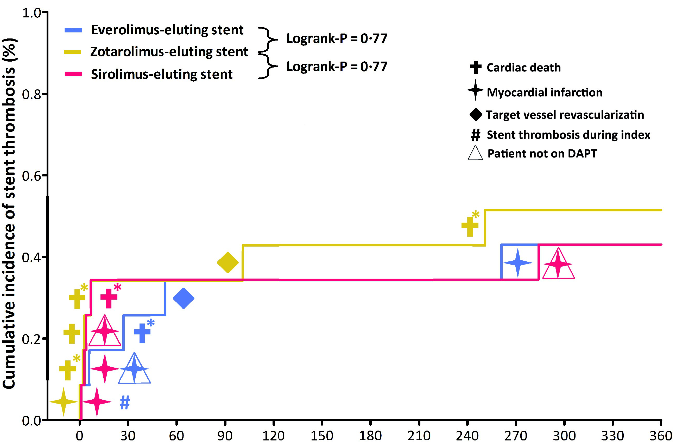
Definite or Probable Stent Thrombosis
Synergy
Logrank-P = 0.77
Cardiac Death
Resolute Integrity
Myocardial Infarction
Orsiro
Logrank-P = 0.77
Target Vessel Revascularization
#
Stent Thrombosis during index
Patient not on DAPT
A (*) signifies probable stent thromboses
(5 fatal events); all other events represent definitive stent thromboses (1 fatal event)
0.5%
0.4%
Definite ST occurred in 4 (0.3%), 3 (0.3%), and 4 (0.3%) pts., respectively (Logrank-P = 0.70, for both main comparisons).
Time after initial procedure (days)
Stent thrombosis (ST) was defined according to the Academic Research Consortium (ARC). DAPT = dual antiplatelet therapy.

Slide 11
BIONICS Trial BioNIR Ridaforolimus Eluting Coronary Stent System In Coronary Stenosis Trial
David E. Kandzari, MD
on behalf of the
BIONICS investigators

Slide 12
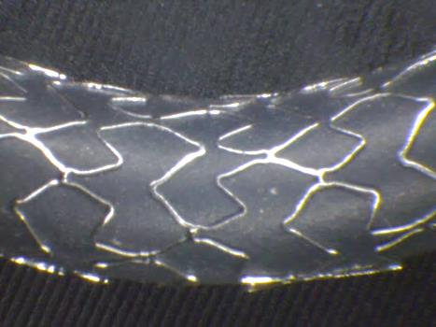
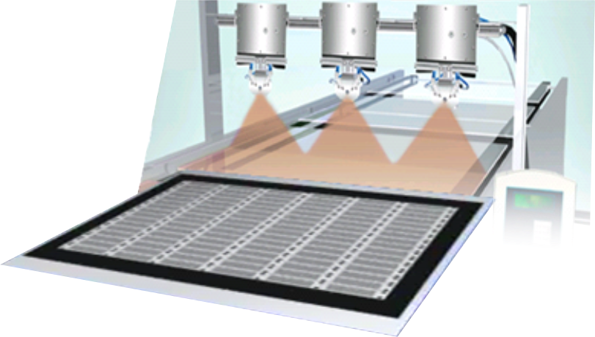
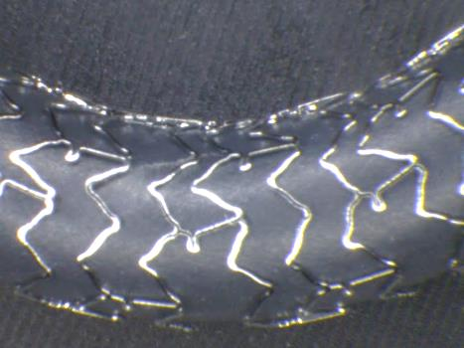
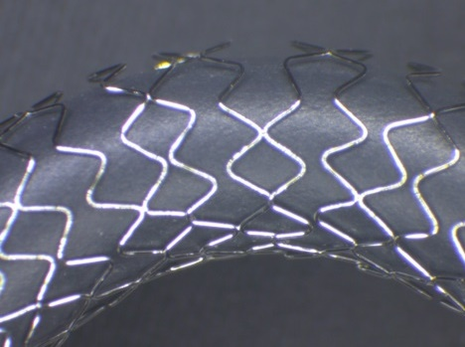
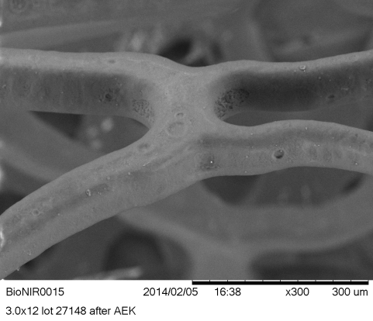
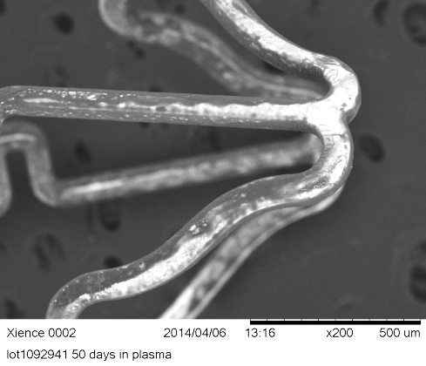
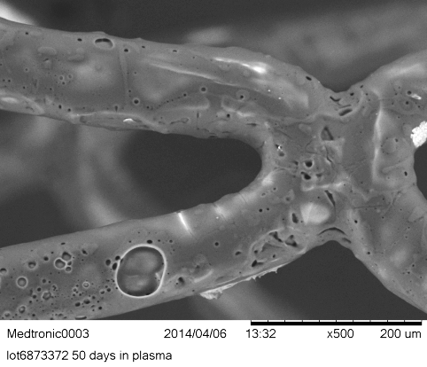
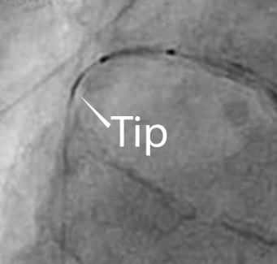
BioNIR System
Flat manufacturing: Quality & cost efficiency
Variable strut width/ frequency: Uniform dosing
BioNIR
- 80µm CoCr Wizecell design
- Ridaforolimus high therapeutic index drug
DES A
DES B
Elastomeric Polymer: Remains intact post elution
Spring tip: Pushable & visible
BioNIR
DES A
DES B
Medinol Ltd., Tel Aviv, Israel

Slide 13
BIONICS – Trial Design
“More Comers” Population with
Symptomatic CAD
(eg, NSTEMI, CTO, SVG, MVD)
BioNIR Stent
N=958
76 Centers in NA, Europe, Israel
FAS*:1919 patients randomized 1:1
Resolute Stent
N=961
Noninferiority Design
(Event rate 5.8%, Delta 3.3%, Power 90%)
Primary Clinical Endpoint
Follow Up
30d
6mo
12mo
13mo
2yr
3yr
4yr
5yr
QCA & Imaging Endpoints
Primary Endpoint:
12-month target lesion failure (TLF), composite of cardiac death, target vessel MI and ischemia driven TLR
Secondary Endpoints:
12-month MACE, TVF and individual component endpoints
Definite/probable stent thrombosis
Procedural success
*FAS= Full Analysis Set

Slide 14
BIONICS TLF to 12 Months: KM Curves
10
HR: 1.00 [95% CI: 0.67, 1.49]
8
BioNIR
Resolute
P=0.997
6
5.3%
Target Lesion Failure (%)
5.1%
4
2
0
0
4
8
12
Time in Months
No. at risk
BioNIR
Resolute
958
961
924
922
914
907
896
894
436
439

Slide 15
BIONICS Stent Thrombosis
 | BioNIR (N=958) | Resolute (N=961) | P value
Stent Thrombosis
Definite/Probable | 0.4% (4/921) | 0.6% (6/927) | 0.75
Definite | 0.4% (4/921) | 0.5% (5/926) | 1.00
Any Stent Thrombosis | 0.4% (4/921) | 0.8% (7/928) | 0.37
Timing of Event
Acute ST | 0.1% (1/920) | 0.1% (1/926) | 1.00
Sub-Acute ST | 0.3% (3/921) | 0.3% (3/927) | 1.00
Late | 0.0% (0/920) | 0.3% (3/927) | 0.25
12 Month DAPT Adherence: 75.1% BioNiR, 75.9% Resolute

Slide 16
Didactic Session: The TCT Late Breaking Trials: Highlights – and my Interpretations – from: BIO-RESORT (TWENTE III) and BIONICS
Key data of these studies
Putting these studies into perspective
Did these studies change my everyday practice ?
Conclusions

Slide 17
Didactic Session: The TCT Late Breaking Trials: Highlights – and my Interpretations – from: BIO-RESORT (TWENTE III) and BIONICS
Key data of these studies
Putting these studies into perspective
Was the Resolute the right DES to be used as the reference stent – or would it have been more appropriate to have chosen the Xience for reference ?

Slide 18
RESOLUTE All Comers Randomized Trial

Slide 19
RESOLUTE All Comers-RCT– 5 Years
Target Lesion Failure (TLF)
40
Resolute™ ZES (N = 1140)
Log rank P = 0.65
Xience V™ EES (N = 1152)
30
Primary endpoint
P_{non-inferiority} <0.001
Cumulative Incidence
of TLF (%)
20
17.1%
8.3%
16.3%
8.2%
10
0
0
1
2
3
4
5
Time After Initial Procedure (years)
No. at risk
Resolute | 1140 |  |  |  | 1110 |  |  |  | 1035 |  |  | 992 |  |  | 960 |  | 920
Xience V | 1152 |  |  |  | 1122 |  |  |  | 1031 |  |  | 995 |  |  | 959 |  | 926
TLF (Target Lesion Failure) is defined as cardiac death, TVMI, or clinically driven TLR.

Slide 20
RESOLUTE All Comers-RCT– 5 Years
Stent Thrombosis - Definite
10
Resolute™ ZES (N = 1140)
Log rank P = 0.08
Xience V™ EES (N = 1152)
8
6
Cumulative Incidence of
ARC Definite ST (%)
4
2
1.62%
0.82%
0
0
1
2
3
4
5
Time After Initial Procedure (years)
No. at risk
Resolute | 1140 |  |  |  | 1135 |  |  |  | 1100 |  |  | 1075 |  |  | 1049 |  | 1011
Xience V | 1152 |  |  |  | 1150 |  |  |  | 1105 |  |  | 1084 |  |  | 1054 |  | 1024

Slide 21
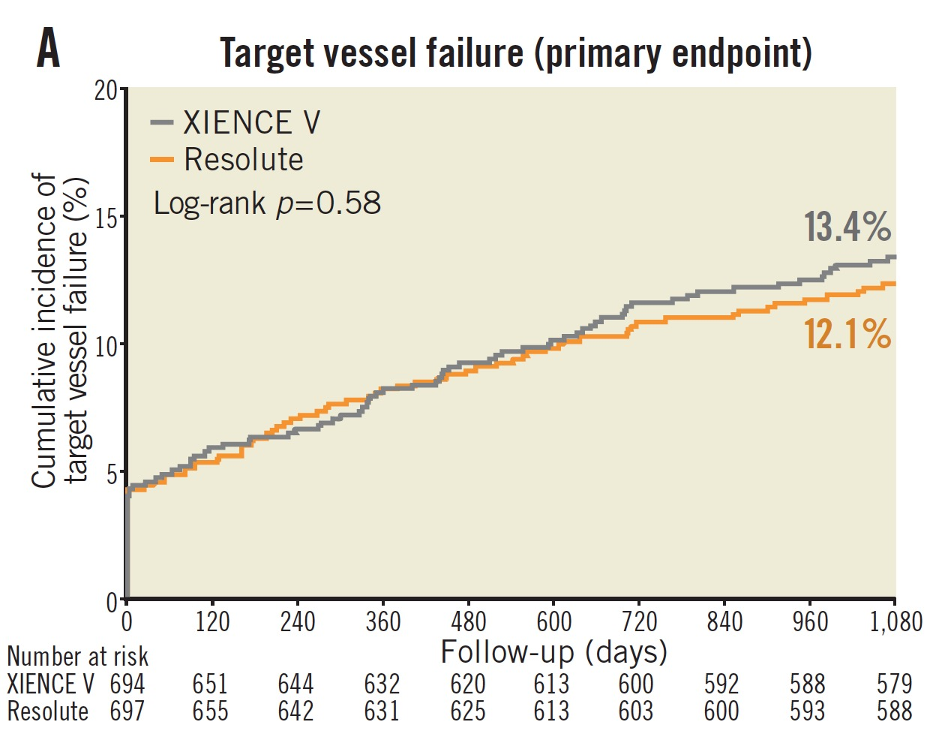
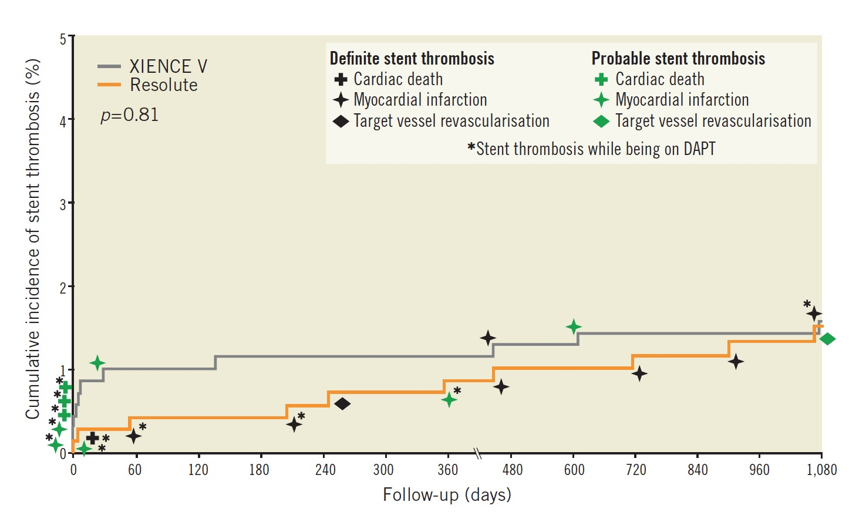
Eurointervention 10: 1276-1279 (2015)

Slide 22
TWENTE-I 5y and TWENTE-II 3y
Durable Polymer
Resolute Integrity
CoCr – zotarolimus-eluting stent
Follow-up (days)
von Birgelen, TCT 2015
Follow-up (days)
van der Heijden, EuroIntervention, in press
TWENTE trial: 5-year follow-up
Primary Outcome von Birgelen et al. J Am Coll Cardiol 2012; 59: 1350–61
2-Year Follow-up Tandjung et al. J Am Coll Cardiol 2014; 61: 2406–16
3-Year Follow-up Löwik et al. EuroIntervention 2015; 10: 1276–9
DUTCH PEERS (TWENTE II) trial: 3-year follow-up
Primary Outcome von Birgelen et al. Lancet 2014; 383: 413–23
2-Year Follow-up Sen et al. J Am Coll Cardiol Intv 2015; 8: 889–99
3-Year Follow-up van der Heijden et al. EuroIntervention – in press
Notes:
21
This is the Bulleted List slide.
To create this particular slide, click the NEW SLIDE button on your toolbar and choose the BULLETED LIST format. (Top row, second from left)
The Sub-Heading and footnote will not appear when you insert a new slide. If you need either one, copy and paste it from the sample slide.
If you choose not to use a Sub-Heading, let us know when you hand in your presentation for clean-up and we’ll adjust where the bullets begin on your master page.
Also, be sure to insert the presentation title onto the BULLETED LIST MASTER as follows:
Choose View / Master / Slide Master from your menu.
Select the text at the bottom of the slide and type in a short version of your presentation title.
Click the SLIDE VIEW button in the lower left hand part of your screen to return to the slide show. (Small white rectangle)

Slide 23
Didactic Session: The TCT Late Breaking Trials: Highlights – and my Interpretations – from: BIO-RESORT (TWENTE III) and BIONICS
Key data of these studies
Putting these studies into perspective
Was the Resolute the right DES to be used as the reference stent – or would it have been more appropriate to have chosen the Xience for reference ?
YES !

Slide 24
Didactic Session: The TCT Late Breaking Trials: Highlights – and my Interpretations – from: BIO-RESORT (TWENTE III) and BIONICS
Key data of these studies
Putting these studies into perspective
Were the results of BIONICS unexptected ?

Slide 25
Primary endpoint results from the NIREUS trial A prospective randomised trial comparing the novel ridaforolimus-eluting BioNIR stent to the zotarolimus-eluting Resolute stent
Pieter C. Smits
On behalf of all NIREUS investigators
In Greek mythology, Nireus was king of the island Syme and one of the Achaean leaders in the Trojan War.
He was renowned for his outstanding beauty, being described as the second most handsome man in the Greek camp after Achilles

Slide 26
6 months

Slide 27
12 months Clinical results
 | BioNIR (N=201) | Resolute (N=101) | Hazard Ratio [95% CI] | p-value
Target lesion failure (TLF) | 3.4% (6) | 5.9% (6) | 0.50 [0.16 – 1.55] | 0.23
Target vessel failure (TVF) | 6.8% (13) | 7.9% (8) | 0.82 [0.34 – 1.97] | 0.65
MACE | 4.3% (8) | 5.9% (6) | 0.67 [0.23 – 1.92] | 0.45
All-cause mortality | 1.5% (3) | 0.0% (0) | N/A | 1.00
Cardiac death | 0.5% (1) | 0.0% (0) | N/A | 1.00
Myocardial Infarction | 2.0% (4) | 3.0% (3) | 0.67 [0.15 - 2.97] | 0.59
Target vessel MI | 1.0% (2) | 3.0% (3) | 0.33 [0.06 - 1.99] | 0.23
Ischemia-driven TLR | 2.4% (4) | 3.0% (3) | 0.68 [0.15 – 3.04] | 0.61
Ischemia-driven TVR | 4.9% (9) | 5.9% (6) | 0.77 [0.27 - 2.15] | 0.61
Stent Thrombosis (ARC def/prob) | 0.5% (1) | 0.0% (0) | N/A | 0.48
TLF = Composite of cardiac death, target vessel related MI or ischemia-driven TLR
MACE = Composite of cardiac death, any MI or ischemia-driven TLR
TVF = Composite of death, target vessel related MI or ischemia-driven TVR
Notes:
No additional ST between 6-12 months
Cardiac death case was the same patient with the subacute and late ST, resulting in EF of 25%

Slide 28
Didactic Session: The TCT Late Breaking Trials: Highlights – and my Interpretations – from: BIO-RESORT (TWENTE III) and BIONICS
Key data of these studies
Putting these studies into perspective
Were the results of BIONICS unexptected ?
NO !

Slide 29
Didactic Session: The TCT Late Breaking Trials: Highlights – and my Interpretations – from: BIO-RESORT (TWENTE III) and BIONICS
Key data of these studies
Putting these studies into perspective
Did these studies change my everyday practice ?
Conclusions

Slide 30
Didactic Session: The TCT Late Breaking Trials: Highlights – and my Interpretations – from: BIO-RESORT (TWENTE III) and BIONICS
Key data of these studies
Putting these studies into perspective
Did these studies change my everyday practice ?
NO !
...because I am not using DES with biodegradable polymers,
and the Resolute DES is my workhorse anyway

Slide 31
Didactic Session: The TCT Late Breaking Trials: Highlights – and my Interpretations – from: BIO-RESORT (TWENTE III) and BIONICS
Key data of these studies
Putting these studies into perspective
Did these studies change my everyday practice ?
Conclusions

Slide 32
Didactic Session: The TCT Late Breaking Trials: Highlights – and my Interpretations – from: BIO-RESORT (TWENTE III) and BIONICS
Conclusions:
The concept of avoiding durable or even any polymer on DES is intriguing, because many of the late events might possibly be due to polymer-induced late neoatherosclerosis.
However, neoatherosclerosis also occurs with bare metal stents.
So far, no evidence-based clinical data exist showing superiority of biodegradable polymer-based vs. durable polymer-based DES.
Today, even a “protective” effect of some polymers is discussed.
Modern DES with durable polymers are the “gold standard” and hard to beat.
Avoiding biodegradable polymer-based DES does not put the patients at risk and saves health care costs.

